Slide 1
System Integration and Architecture II
Chapter 5 Database Systems, Data Centers, and Business Intelligence

Slide 2
Principles and Learning Objectives
Data management and modeling are key aspects of organizing data and information
Define general data management concepts and terms, highlighting the advantages of the database approach to data management
Describe logical and physical database design considerations, the function of data centers, and the relational database model

Slide 3
Principles and Learning Objectives (continued)
A well-designed and well-managed database is an extremely valuable tool in supporting decision making
Identify the common functions performed by all database management systems, and identify popular database management systems
The number and types of database applications will continue to evolve and yield real business benefits
Identify and briefly discuss business intelligence, data mining, and other database applications

Slide 4
Why Learn About Database Systems and Business Intelligence?
Database:
Organized collection of data
Database management system (DBMS):
Group of programs that manipulate the database
Provide an interface between the database and its users and other application programs
Database administrator (DBA):
Skilled IS professional who directs all activities related to an organization’s database

Slide 5
Data Management
Without data and the ability to process it:
An organization could not successfully complete most business activities
Data consists of raw facts
To transform data into useful information:
It must first be organized in a meaningful way

Slide 6
The Hierarchy of Data
Bit (a binary digit):
Circuit that is either on or off
Byte:
Typically made up of eight bits
Character:
Basic building block of information
Field:
Name, number, or combination of characters that describes an aspect of a business object or activity

Slide 7
The Hierarchy of Data (continued)
Record:
Collection of related data fields
File:
Collection of related records
Database:
Collection of integrated and related files
Hierarchy of data:
Bits, characters, fields, records, files, and databases

Slide 8
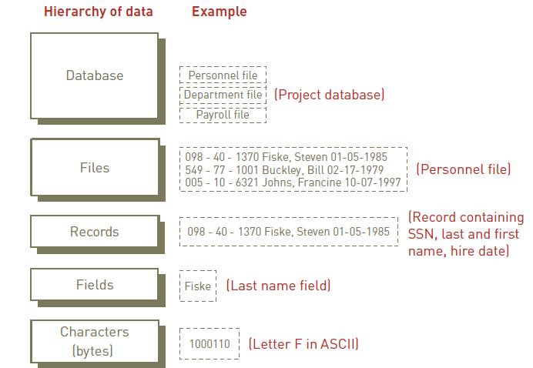

The Hierarchy of Data (continued)

Slide 9
Data Entities, Attributes, and Keys
Entity:
Generalized class of people, places, or things (objects) for which data is collected, stored, and maintained
Attribute:
Characteristic of an entity
Data item:
Specific value of an attribute

Slide 10
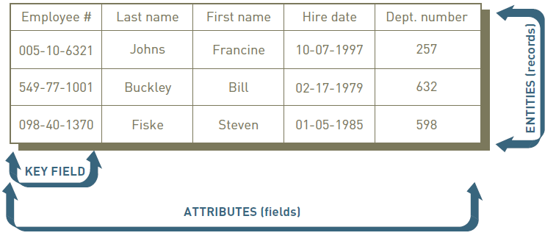
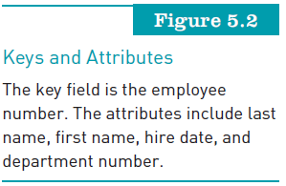
Data Entities, Attributes, and Keys (continued)

Slide 11
Data Entities, Attributes, and Keys (continued)
Key:
Field or set of fields in a record that is used to identify the record
Primary key:
Field or set of fields that uniquely identifies the record

Slide 12
The Database Approach
The database approach:
Traditional approach to data management:
Each distinct operational system used data files dedicated to that system
Database approach to data management:
Pool of related data is shared by multiple application programs

Slide 13
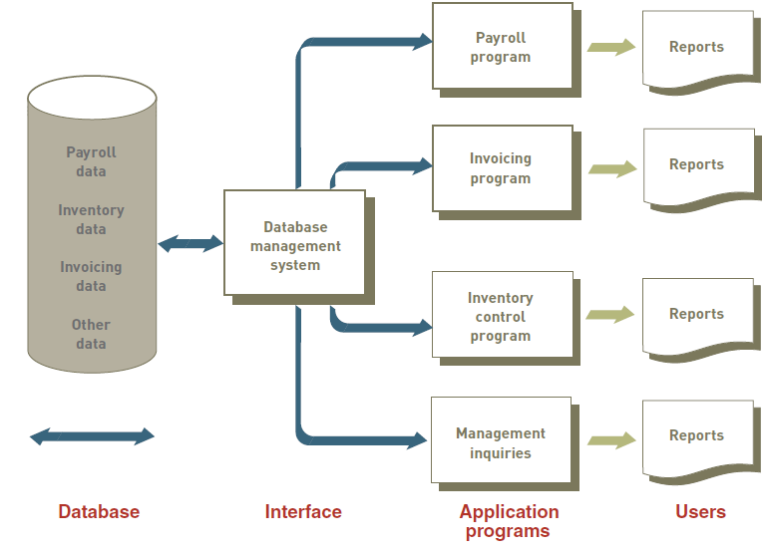
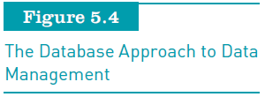
The Database Approach (continued)

Slide 14
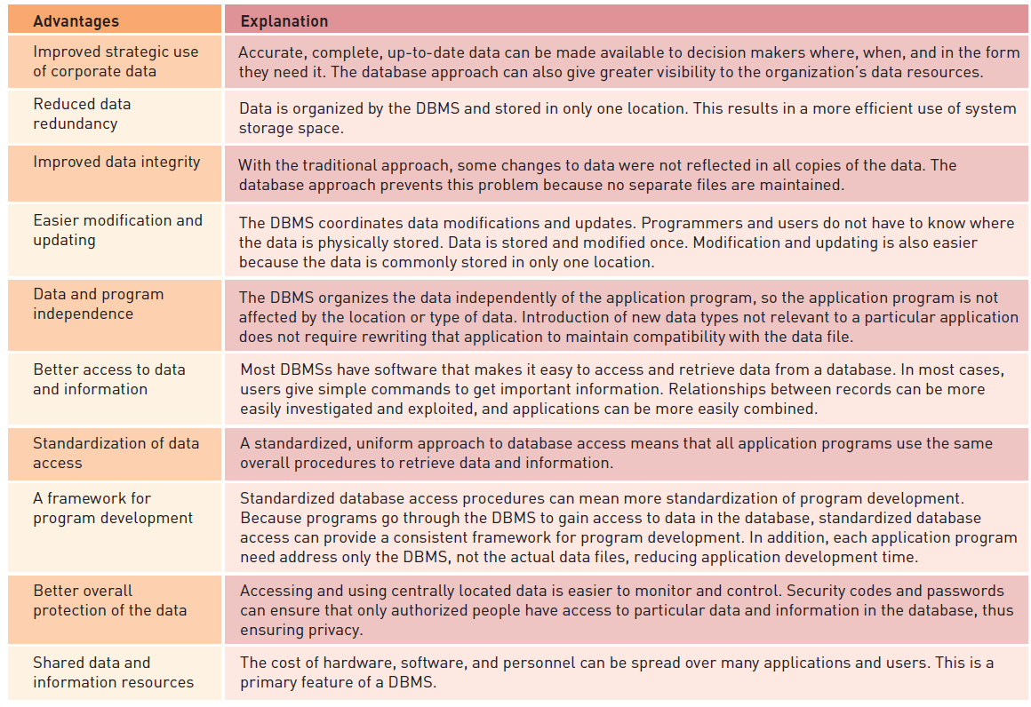
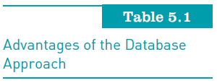

Slide 15
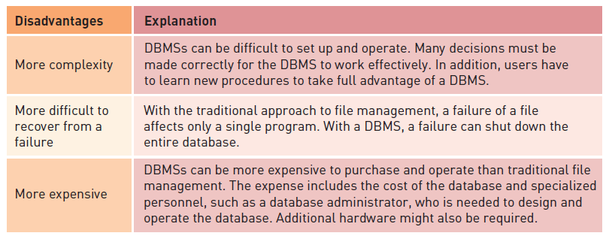
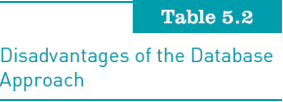
The Database Approach (continued)

Slide 16
Data Modeling and Database Characteristics
When building a database, an organization must consider:
Content: What data should be collected and at what cost?
Access: What data should be provided to which users and when?
Logical structure: How should data be arranged so that it makes sense to a given user?
Physical organization: Where should data be physically located?

Slide 17
Data Center
Climate-controlled building or set of buildings that:
House database servers and the systems that deliver mission-critical information and services
Traditional data centers:
Consist of warehouses filled with row upon row of server racks and powerful cooling systems

Slide 18
Data Modeling
Building a database requires two types of designs:
Logical design:
Abstract model of how data should be structured and arranged to meet an organization’s information needs
Physical design:
Starts from the logical database design and fine-tunes it for performance and cost considerations
Planned data redundancy:
Done to improve system performance so that user reports or queries can be created more quickly

Slide 19
Data Modeling (continued)
Data model:
Diagram of data entities and their relationships
Enterprise data modeling:
Starts by investigating the general data and information needs of the organization at the strategic level
Entity-relationship (ER) diagrams:
Data models that use basic graphical symbols to show the organization of and relationships between data

Slide 20
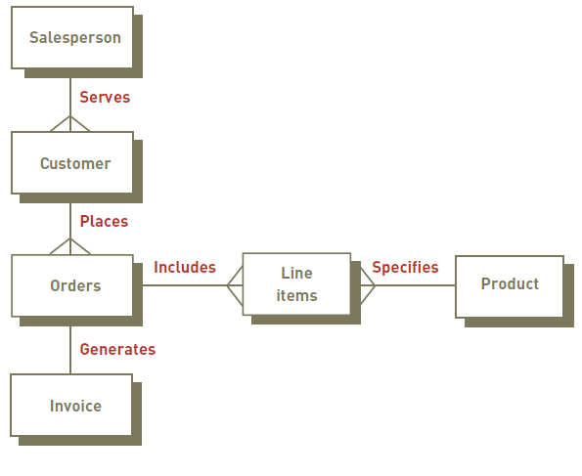
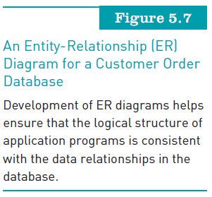

Slide 21
The Relational Database Model
Relational model:
Describes data using a standard tabular format
Each row of a table represents a data entity (record)
Columns of the table represent attributes (fields)
Domain:
Allowable values for data attributes

Slide 22
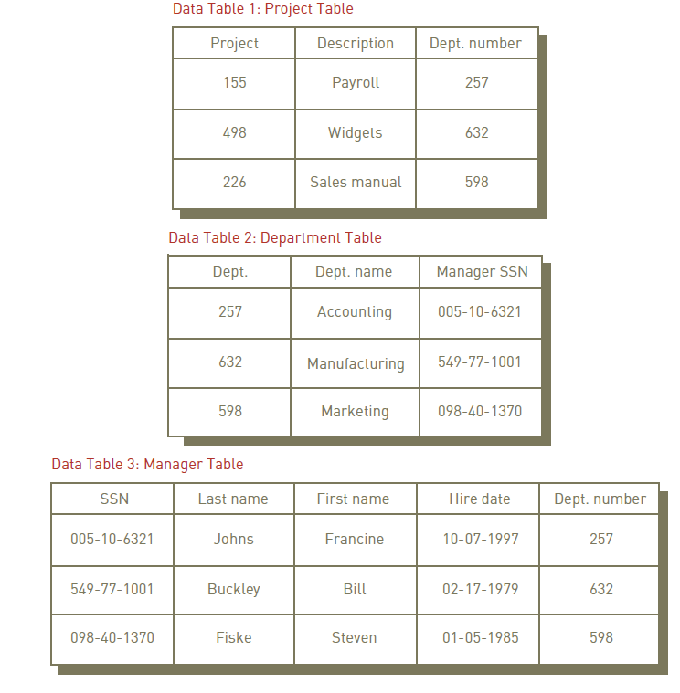
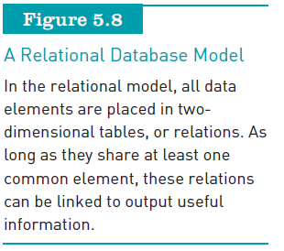

Slide 23
The Relational Database Model (continued)
Manipulating data:
Selecting:
Eliminates rows according to certain criteria
Projecting:
Eliminates columns in a table
Joining:
Combines two or more tables
Linking:
Manipulating two or more tables that share at least one common data attribute

Slide 24
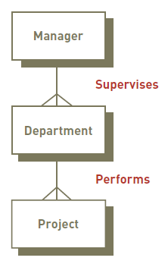
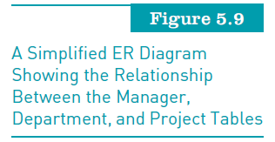
The Relational Database Model (continued)

Slide 25
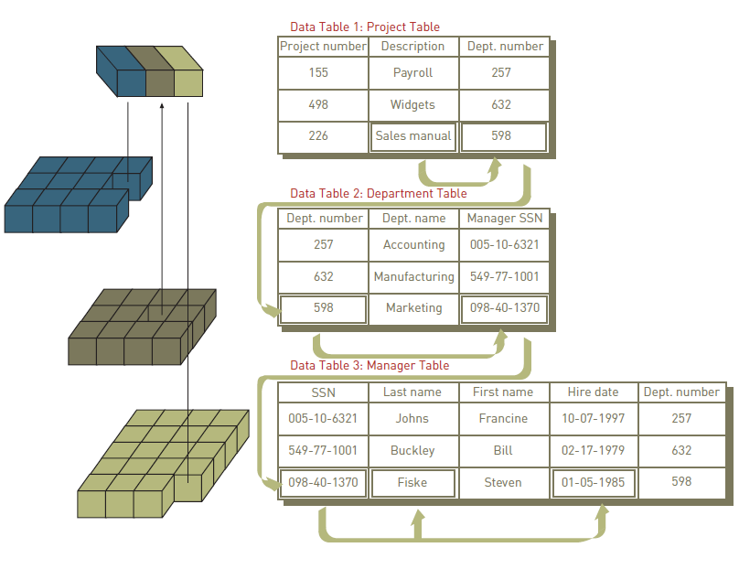
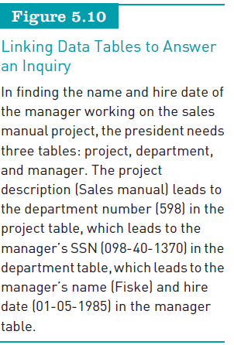
The Relational Database Model (continued)

Slide 26
The Relational Database Model (continued)
Data cleanup
Process of looking for and fixing inconsistencies to ensure that data is accurate and complete
Data anomalies:
Often result in incorrect information, causing database users to be misinformed about actual conditions
Must be corrected

Slide 27
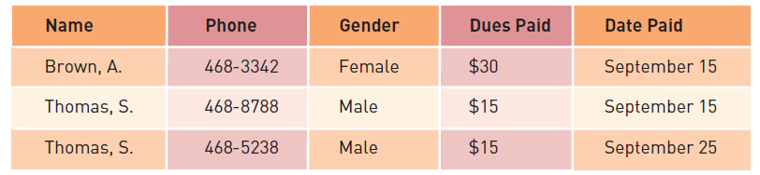

The Relational Database Model (continued)

Slide 28
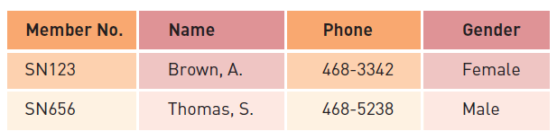

The Relational Database Model (continued)

Slide 29
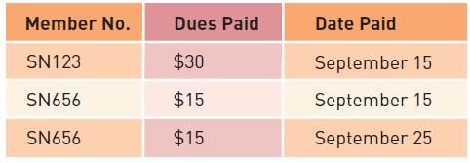

The Relational Database Model (continued)

Slide 30
Database Management Systems
Creating and implementing the right database system:
Ensures that the database will support both business activities and goals
Capabilities and types of database systems vary considerably

Slide 31
Overview of Database Types
Flat file
Simple database program whose records have no relationship to one another
Single user
Only one person can use the database at a time
Examples: Access, FileMaker Pro, and InfoPath
Multiple users
Allow dozens or hundreds of people to access the same database system at the same time
Examples: Oracle, Sybase, and IBM

Slide 32
Providing a User View
Schema:
Used to describe the entire database
Can be part of the database or a separate schema file
DBMS:
Can reference a schema to find where to access the requested data in relation to another piece of data

Slide 33
Creating and Modifying the Database
Data definition language (DDL):
Collection of instructions and commands used to define and describe data and relationships in a specific database
Allows database’s creator to describe data and relationships that are to be contained in the schema
Data dictionary:
Detailed description of all the data used in the database

Slide 34
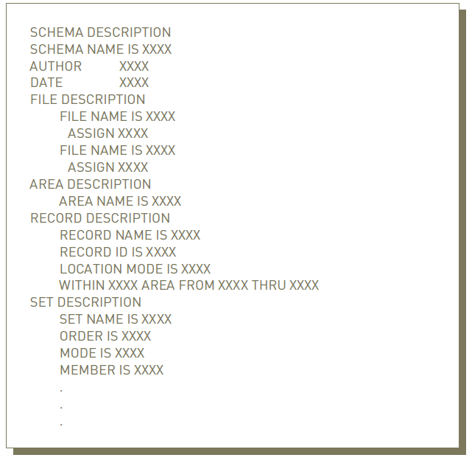
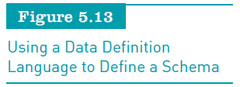
Creating and Modifying the Database (continued)

Slide 35
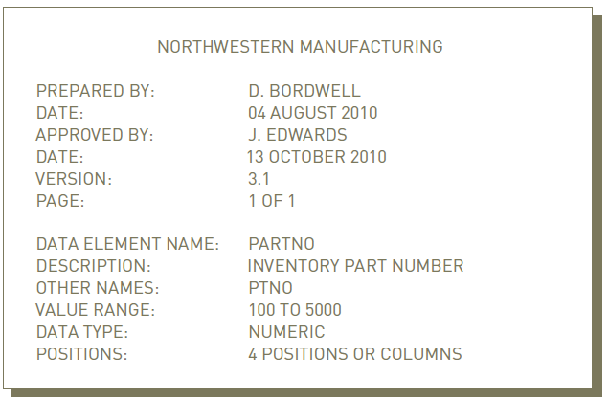

Creating and Modifying the Database (continued)

Slide 36
Storing and Retrieving Data
When an application program needs data:
It requests the data through the DBMS
Concurrency control:
Method of dealing with a situation in which two or more users or applications need to access the same record at the same time

Slide 37
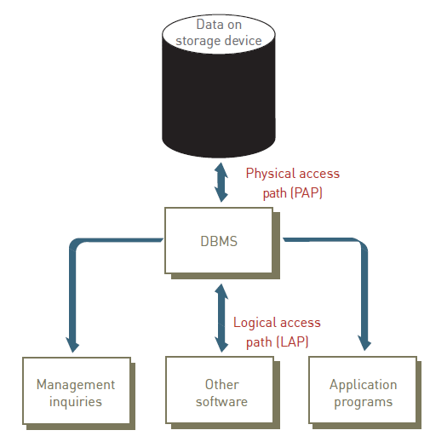
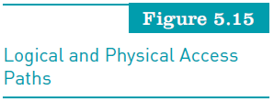

Slide 38
Manipulating Data and Generating Reports
Data manipulation language (DML):
Commands that manipulate the data in a database
Structured query language (SQL):
Adopted by the American National Standards Institute (ANSI) as the standard query language for relational databases
Once a database has been set up and loaded with data:
It can produce reports, documents, and other outputs

Slide 39
Database Administration
DBA:
Works with users to decide the content of the database
Works with programmers as they build applications to ensure that their programs comply with database management system standards and conventions
Data administrator:
Responsible for defining and implementing consistent principles for a variety of data issues

Slide 40
Popular Database Management Systems
Popular DBMSs for end users:
Microsoft’s Access and FileMaker Pro
Database as a Service (DaaS):
Emerging database system
Database administration is provided by the service provider
The database is stored on a service provider’s servers and accessed by the client over a network

Slide 41
Special-Purpose Database Systems
Some specialized database packages are used for specific purposes or in specific industries:
Rex-Book from Urbanspoon
Morphbank (www.morphbank.net):
Allows researchers to continually update and expand a library of more than 96,000 biological images

Slide 42
Selecting a Database Management System
Important characteristics of databases to consider:
Database size
Database cost
Concurrent users
Performance
Integration
Vendor

Slide 43
Using Databases with Other Software
DBMSs can act as front-end or back-end applications:
Front-end applications interact directly with people
Back-end applications interact with other programs or applications

Slide 44
Database Applications
Today’s database applications manipulate the content of a database to produce useful information
Common manipulations:
Searching, filtering, synthesizing, and assimilating data contained in a database using a number of database applications

Slide 45
Linking Databases to the Internet
Semantic Web:
Developing a seamless integration of traditional databases with the Internet
Provides metadata with all Web content using technology called the Resource Description Framework (RDF)

Slide 46
Data Warehouses, Data Marts, and Data Mining
Data warehouse
Database that holds business information from many sources in the enterprise
Data mart
Subset of a data warehouse
Data mining
Information-analysis tool that involves the automated discovery of patterns and relationships in a data warehouse

Slide 47
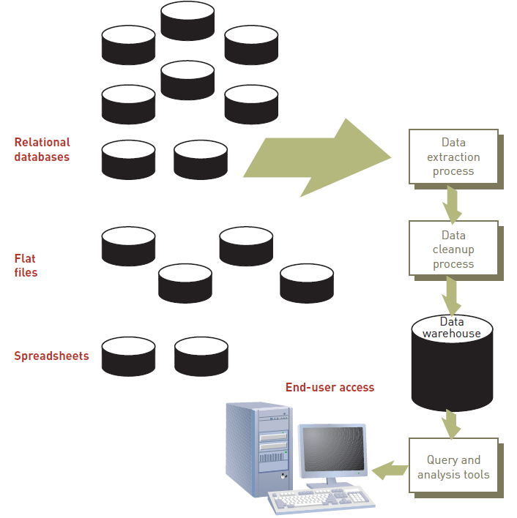


Slide 48
Data Warehouses, Data Marts, and Data Mining (continued)
Predictive analysis:
Form of data mining that combines historical data with assumptions about future conditions to predict outcomes of events
Used by retailers to upgrade occasional customers into frequent purchasers
Software can be used to analyze a company’s customer list and a year’s worth of sales data to find new market segments

Slide 49
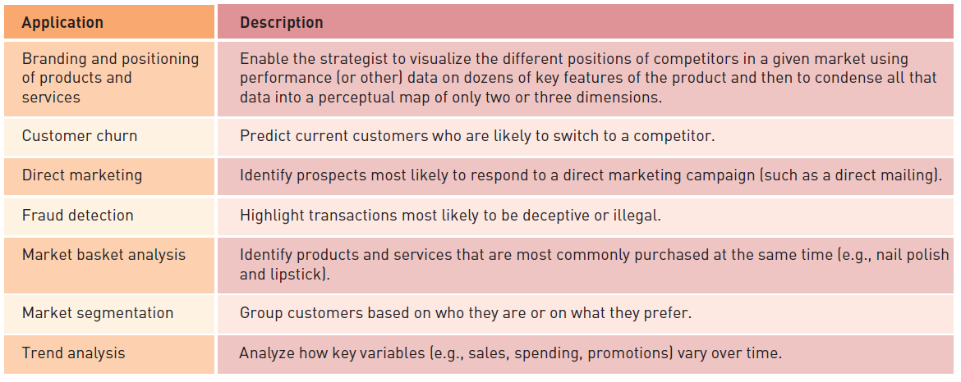
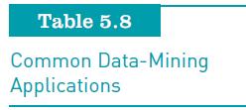
Data Warehouses, Data Marts, and Data Mining (continued)

Slide 50
Business Intelligence
Involves gathering enough of the right information:
In a timely manner and usable form and analyzing it to have a positive impact on business strategy, tactics, or operations
Competitive intelligence:
Limited to information about competitors and the ways that knowledge affects strategy, tactics, and operations

Slide 51
Business Intelligence (continued)
Counterintelligence:
Steps organization takes to protect information sought by “hostile” intelligence gatherers
Data loss prevention (DLP):
Refers to systems designed to lock down data within an organization
Powerful tool for counterintelligence
A necessity in complying with government regulations that require companies to safeguard private customer data

Slide 52
Distributed Databases
Distributed database:
Database in which the data may be spread across several smaller databases connected via telecommunications devices
Gives corporations more flexibility in how databases are organized and used
Replicated database:
Holds a duplicate set of frequently used data

Slide 53
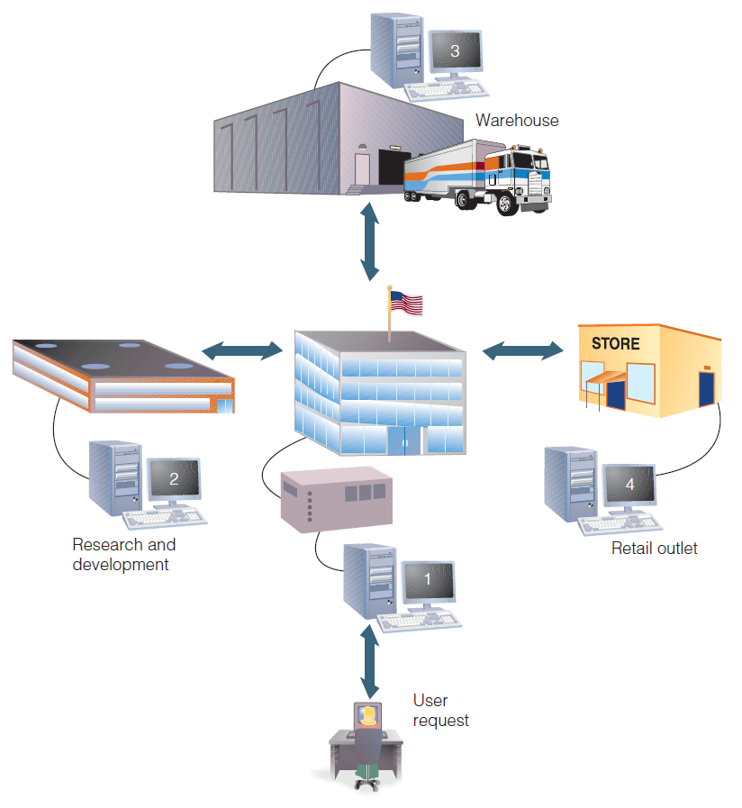
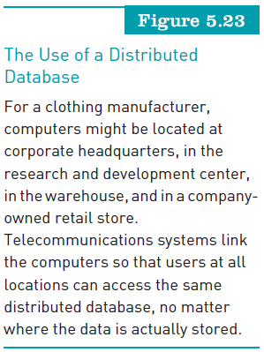
Distributed Databases (continued)

Slide 54
Online Analytical Processing (OLAP)
Software that allows users to explore data from a number of different perspectives
Provides top-down, query-driven data analysis
Requires repetitive testing of user-originated theories
Requires a great deal of human ingenuity and interaction with the database to find information

Slide 55
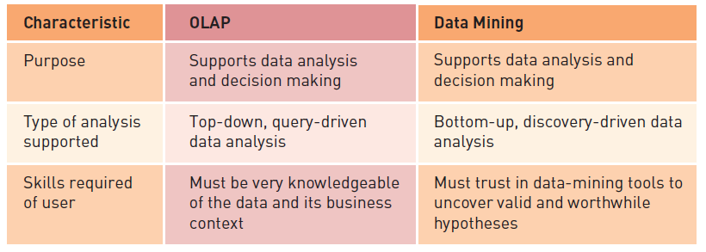
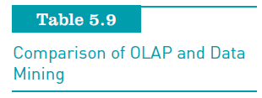
Online Analytical Processing (OLAP) (continued)

Slide 56
Object-Relational Database Management Systems
Object-oriented database:
Stores both data and its processing instructions
Uses an object-oriented database management system (OODBMS) to provide a user interface and connections to other programs
Object-relational database management system (ORDBMS)
Provides the ability for third parties to add new data types and operations to the database

Slide 57
Visual, Audio, and Other Database Systems
Visual databases:
Can be stored in some object-relational databases or special-purpose database systems
Virtual database systems:
Allow different databases to work together as a unified database system
Spatial data technology:
Using database to store and access data according to the locations it describes

Slide 58
Summary
Data:
One of the most valuable resources that a firm possesses
Entity:
Generalized class of objects for which data is collected, stored, and maintained
Traditional file-oriented applications:
Often characterized by program-data dependence
Relational model:
Places data in two-dimensional tables

Slide 59
Summary (continued)
DBMS:
Group of programs used as an interface between a database and its users and other application programs
Basic functions:
Providing user views
Creating and modifying the database
Storing and retrieving data
Manipulating data and generating reports

Slide 60
Summary (continued)
Data warehouses:
Relational database management systems specifically designed to support management decision making
Data mining:
Automated discovery of patterns and relationships in a data warehouse
Business intelligence:
Process of getting enough of the right information in a timely manner and usable form

